Slide 1

ECEN 3593-001 Computer Organization
Lecture #36
15 April 2021

Slide 2


Agenda
Class Announcements
Course Project discussion
Chapter 5

Slide 3
Class Announcements
Reading assignment for the week
“Computer Organization and Design, The Hardware / Software Interface, RISC-V edition,” by David Patterson and John Hennessy
ISBN 978-0-12-812275-4
Chapter 5, “Large and Fast: Exploiting Memory Hierarchy”
pages 410-449 (sections 5.5 thru 5.8)
OH today 2:00 to 3:00 in Zoom - https://cuboulder.zoom.us/j/4317981384

Slide 4
Class Announcements
Phases 7/8 are in the deduction period – 1%/day
Phase 9 is in the deduction period – 4%/day
Phase 10 is posted
Target Date Sunday, April 18 at 10:00 PM
Bonus 1%/day, Deduction 4%/day
Homework #5 will be posted by tomorrow night
Due Thursday, April 22 at 10:00 PM
Today and Friday will be about the HW #5 problems

Slide 5
Final Exam
May 3, 1:30 to 4:00 PM, Online
~20 Homework style questions
~30 short questions
Twice as many questions as the MidTerm, but 3 times as much time
The Final Exam is typically quite challenging
There will be a Practice Final available the week before the real Final

Slide 6
Phase 9 Tips
Use multiple input data patterns for no error case
Make sure to exercise all possible single bit errors
Multiple starting patterns will help here also
Read the document carefully about requirements for the test
Make sure phase8_test passes

Slide 7
Associativity Comparison – Direct Mapped
Assume a cache with 4 blocks, 1 word per block
Direct mapped
Access sequence (memory word address)
0 – Miss (Valid = 0)
8 – Miss (Replace)
0 – Miss (Replace)
6 – Miss (Valid = 0)
8 – Miss (Replace)
4 – Miss (Replace)
8 – Miss (Replace)
8 – Hit
4 – Miss (Replace)
Index
0
1
2
3
Mem[8]
Mem[0]
Mem[4]
Mem[6]
Mem[0]
Mem[8]
Mem[8]
Mem[4]
Hit Ratio = 1/9 = 11%

Slide 8
Associativity Comparison – 2-way Set Assoc.
Assume a cache with 4 blocks, 1 word per block
2-way Set Associative
Access sequence (memory word address)
0 – Miss (Valid = 0)
8 – Miss (Valid = 0)
0 – Hit
6 – Miss (Replace)
8 – Miss (Replace)
4 – Miss (Replace)
8 – Hit
8 – Hit
4 – Hit
Set 0
Set 1
Way
0
1
0
1
Mem[0]
Mem[8]
Mem[8]
Mem[4]
Mem[6]
Hit Ratio = 4/9 = 44%

Slide 9
Associativity Comparison – 4-way Set Assoc.
Assume a cache with 4 blocks, 1 word per block
4-way Set Associative
Access sequence (memory word address)
0 – Miss (Valid = 0)
8 – Miss (Valid = 0)
0 – Hit
6 – Miss (Valid = 0)
8 – Hit
4 – Miss (Valid = 0)
8 – Hit
8 – Hit
4 – Hit
Set 0
Way
0
1
2
3
Mem[0]
Mem[8]
Mem[6]
Mem[4]
Hit Ratio = 5/9 = 55%

Slide 10
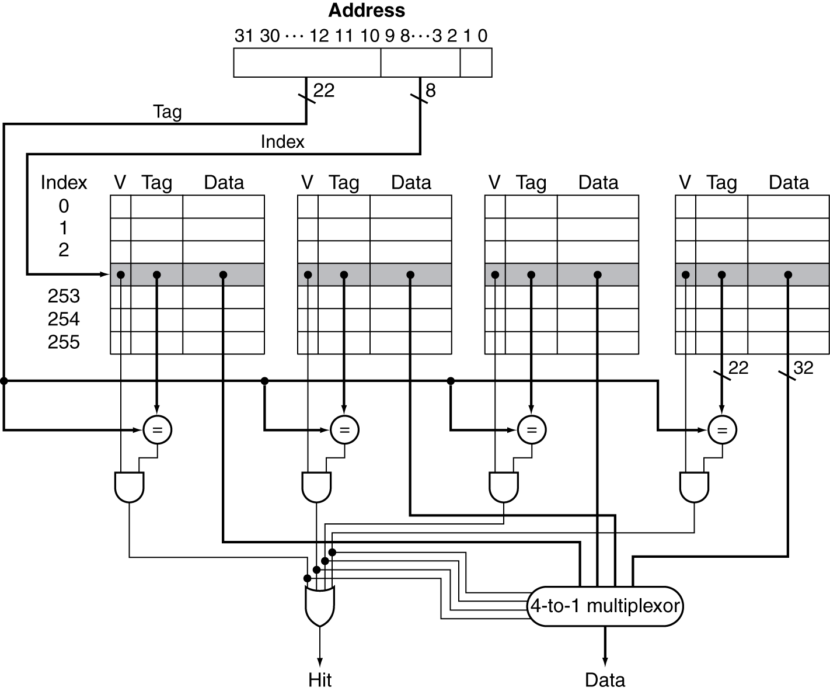
Set Associative Cache Organization
Each Way must have its own comparator.
Each Way requires a multiplexor input
How many comparators would a 4,096 byte fully associative cache with a line of 4 words require?
4,096 bytes / 4 bytes/word= 1,024 words
1,024 words / 4 words/block = 256 blocks
256 comparators and a 256:1 multiplexor!
The additional hardware for a fully associative cache makes it very expensive in terms of silicon real estate as well as execution time!
The increase in cache hit rate decreases with each additional level of associativity. Many systems find the cost / benefit trade off is in the range of 2 to 4.

Slide 11
How Much Associativity
Increased associativity decreases miss rate
But with diminishing returns
Simulation of a system with 64KB D-cache, 16-word blocks, SPEC2000
Miss ratio for various associativities
1-way: 10.3% (this is a Direct Mapped cache)
2-way: 8.6%
4-way: 8.3%
8-way: 8.1%

Slide 12
Defining Cache Size
The size of a cache is the total number of bytes in all the Data Caches (not including the Tag memory)
An n-way Set Associative Cache of size X has X/n bytes per Way
The size of the Way defines how the Address is partitioned
The number of Ways does not affect the address partitioning since all Ways get the same address

Slide 13
Defining Cache Size
Example – 8192 byte 4-way Set Associative Cache, 2 words per line, 32-bit words
Bytes/Way = 8192/4 = 2048 bytes
Words/Way = 2048/4 = 512 words
Lines/Way = 512/2 = 256 lines
Byte Offset = 2 bits
Word Offset = 1 bit
Index = log2(256) = 8 bits
Tag = 32 – 8 – 2 – 1 = 21 bits

Slide 14
Replacement Policy
Least recently used: a replacement scheme in which the block replaced is the one that has been unused for the longest time.
Direct mapped: no choice
Set associative
Select non-valid entry, if there is one
Otherwise, choose among entries in the set
Least-recently used (LRU)
Choose the one unused for the longest time
Simple for 2-way, manageable for 4-way, too hard beyond that
Random
Gives approximately the same performance as LRU for high associativity

Slide 15
Cache Behavior
Cache – 16 blocks of 1 word each
Address sequence (Word addresses)
What are the Upper Address bits (tags - aligned with the byte address) for a Direct Mapped Cache?
First – partition the address
2-way Set Associative cache of the same size – how many sets? (Poll)
dec2hex()
Index
Offset
Not in Tag
Word
Byte
Hex
Binary
Keep the Tag
27
108
0x0000006c
0…000001101100
0…000001000000
123
492
0x000001ec
0…000111101100
0…000011000000
14
56
0x00000038
0…000000111000
0…000000000000
402
1608
0x00000648
0…011001000100
0…011001000000
567
2268
0x000008dc
0…100011011100
0…100011000000
18
72
0x00000048
0…000001001000
0…000001000000
59
236
0x000000ec
0…000011101100
0…000011000000
30
120
0x00000078
0…000001111000
0…000001000000

Slide 16
Cache Behavior
Cache – 16 blocks of 1 word each
What are the tags (aligned with the byte address) for a Direct Mapped Cache?
2-way Set Associative cache of the same size – how many sets?
What are the tags (aligned with the byte address) for this 2-way SA cache?
Cache contents after the address sequence with LRU starting from power up
This access is a hit
Index
Offset
Not in Tag
Word
Byte
Hex
Binary
Keep the Tag
Index
W0
W1
27
108
0x0000006c
0…000001101100
0…000001100000
000b
123
492
0x000001ec
0…000011101100
0…000011100000
001b
402
14
56
0x00000038
0…000000111000
0…000000100000
010b
402
1608
0x00000648
0…011001000100
0…011001000000
011b
27
123
8 Sets
567
2268
0x000008dc
0…100011011100
0…100011000000
100b
27
108
0x0000006c
0…000001101100
0…000011000000
101b
59
236
0x000000ec
0…000011101100
0…000011100000
110b
14
30
120
0x00000078
0…000001111000
0…000001100000
111b
567

Slide 17
Cache Behavior
Cache – 16 blocks of 1 word each
What are the tags (aligned with the byte address) for a Direct Mapped Cache?
2-way Set Associative cache – how many sets?
What are the tags (aligned with the byte address) for this 2-way SA cache?
Cache contents after the address sequence with LRU starting from power up
This is a Replacement due to the Miss
Why did we replace in Set 1?
LRU – Set 0 was accessed more recently
Index
Offset
Not in Tag
Word
Byte
Hex
Binary
Keep the Tag
Index
Set 0
Set 1
27
108
0x0000006c
0…000001101100
0…000001100000
000b
123
492
0x000001ec
0…000011101100
0…000011100000
001b
402
14
56
0x00000038
0…000000111000
0…000000100000
010b
18
402
1608
0x00000648
0…011001000100
0…011001000000
011b
27
59
8 Sets
567
2268
0x000008dc
0…100011011100
0…100011000000
100b
27
108
0x00000048
0…000001001000
0…000001000000
101b
59
236
0x000000ec
0…000011101100
0…000011100000
110b
14
30
30
120
0x00000078
0…000001111000
0…000001100000
111b
567

Slide 18
Cache Behavior
Cache – 16 blocks of 1 word each
What are the tags (aligned with the byte address) for a Direct Mapped Cache?
2-way Set Associative cache – how many sets?
What are the tags (aligned with the byte address) for this 2-way SA cache?
Cache contents after the address sequence with LRU starting from power up
How many blocks were replaced?
1
What is the hit ratio for this sequence?
1/8 = 12.5%
Index
Offset
Not in Tag
Word
Byte
Hex
Binary
Keep the Tag
Index
Set 0
Set 1
27
108
0x0000006c
0…000001101100
0…000001100000
000b
123
492
0x000001ec
0…000011101100
0…000011100000
001b
402
14
56
0x00000038
0…000000111000
0…000000100000
010b
18
402
1608
0x00000648
0…011001000100
0…011001000000
011b
27
59
8 Sets
567
2268
0x000008dc
0…100011011100
0…100011000000
100b
18
72
0x00000048
0…000001001000
0…000001000000
101b
59
236
0x000000ec
0…000011101100
0…000011100000
110b
14
30
30
120
0x00000078
0…000001111000
0…000001100000
111b
567

